Slide 1

Search Engine for
Clinical Trials
Simona Zlatanova 504574
Francesca Visini 502176
Marie Elyse Bassil 503962
IR Project 2024

Slide 2
Technical aspects
Python Programming Language: with the use of NLP libraries: such as spaCy, NLTK, and scikit-learn.
Terrier Information Retrieval Platform: for indexing, query processing, and ranking algorithms.
Evaluation Metrics: Incorporating evaluation metrics from the Terrier platform for continuous performance assessment.
Data Visualization: Utilizing Matplotlib and/or Seaborn for creating visualizations, to facilitate a comprehensive understanding of our system's performance.

Slide 3

Method:
data preprocessing and analysis
indexing
term statistic
query experimentation
query preprocessing
ranking algorithm and retrieval
evaluation

Slide 4
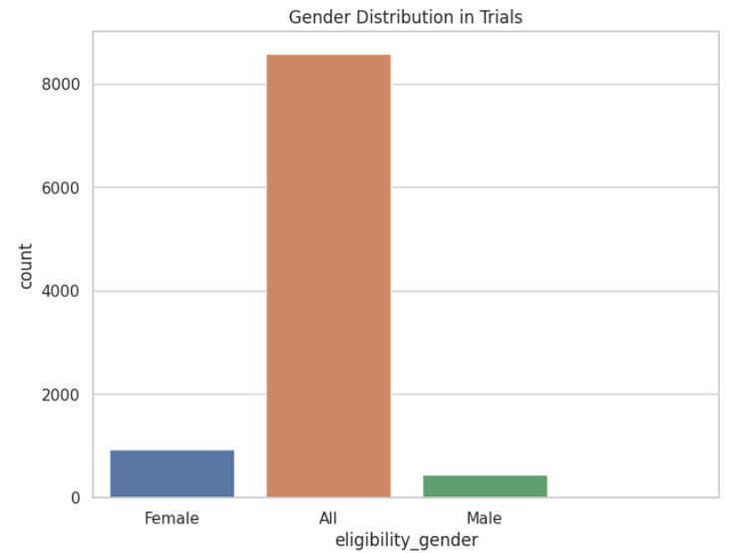
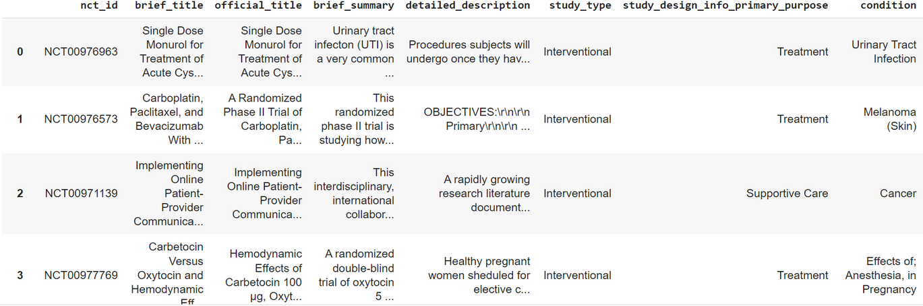
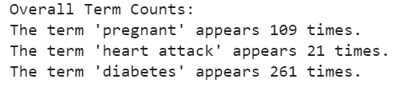
1.DATA PREPROCESSING
Use of ClinicalTrials.gov dataset
preprocessing: NLP techniques such as tokenization, stop word removal, cleaning data...
data analysis of basic statistical information such as docuemnt count, distribution of medical conditions, term occurencies, unique values...

Slide 5
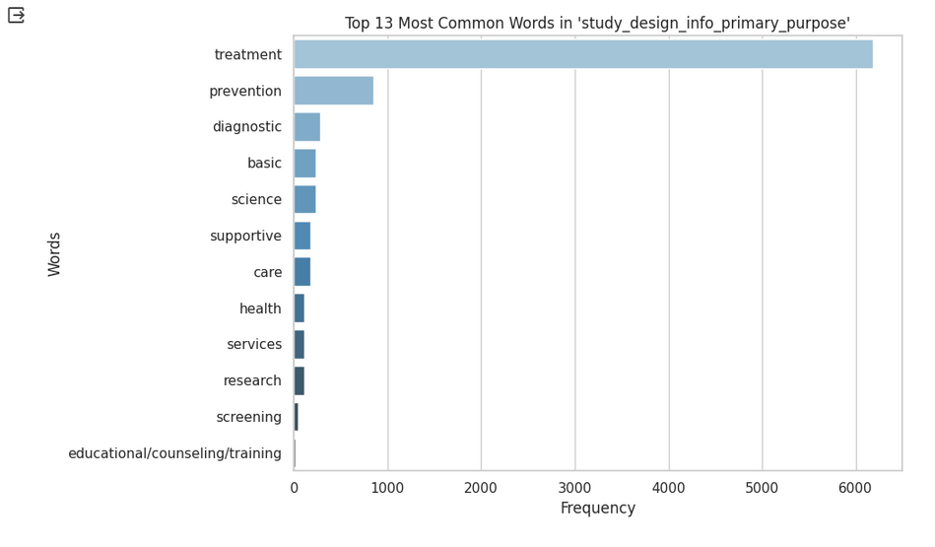
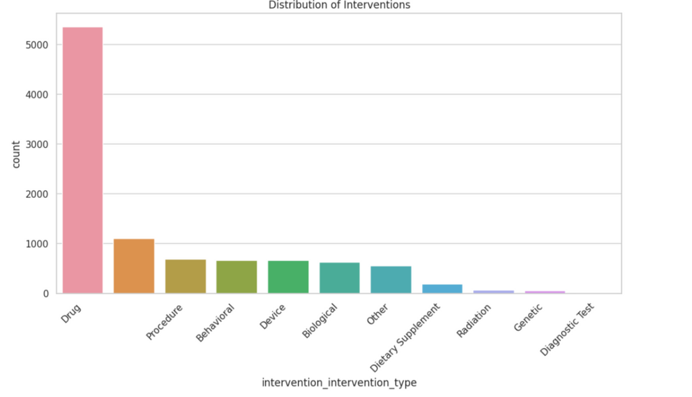
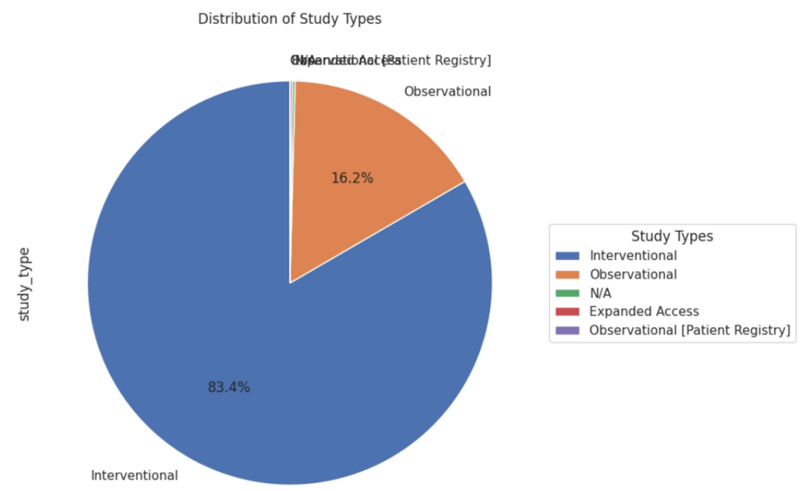
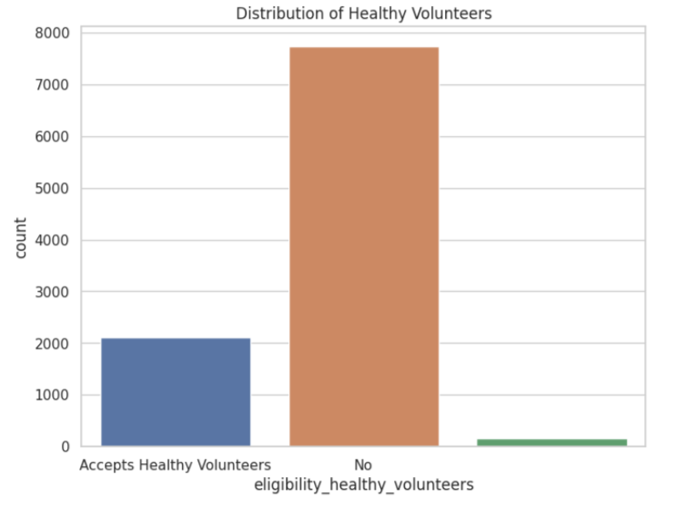
Some data visualizations

Slide 6

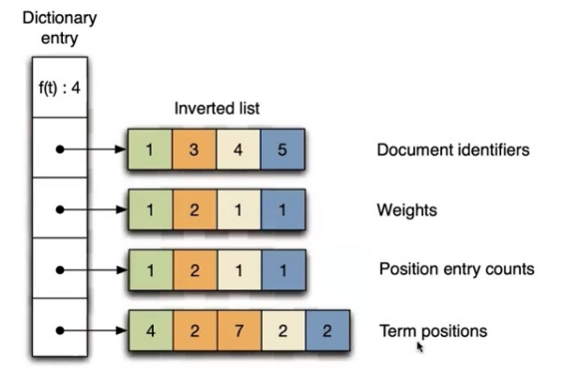
2. INDEXING
is the process aimed at the association of indexes with a text, used to make the retrieval efficient the process of indexing is done offline and the indexes are stored in a data structure called: inverted file structure.
why?
immediate answer to user requests
optimize access to th dictionary
off lineconstruction

Slide 7
The following components should be indexed:
a) Patient Information Section: descriptive medical information, summaries, and eligibility criteria.
b. Title and Abstract
c. Keywords: indexing the keywords
3. TERM STATISTIC
We obtain the occurrences and frequency from the obtained index, this is crucial for term weighting and relevance.

Slide 8

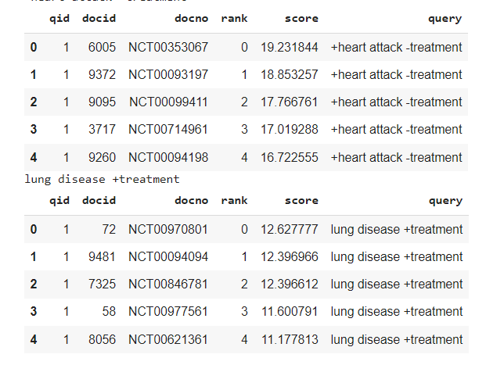
4. QUERY EXPERIMENTATION
Searching an index: we utilized PyTerrier to search the index and retrieve the documents based on a manual query
Experimenting with query language: we investigated the impact of different query formulations, term weights, and Boolean operators on search results by experimenting with different queries.

Slide 9
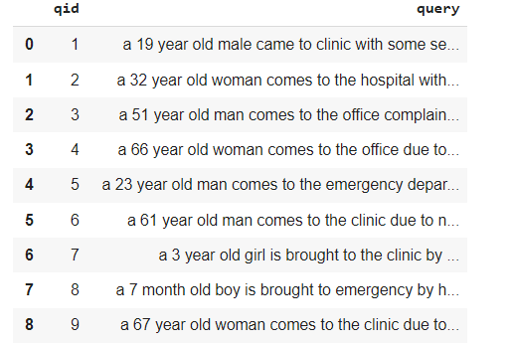
5.QUERY PROCESSING:
load queries and qrels, using an IR-dataset --> crucial for evaluating the performance of an IR system by assessing its alignment with standardized queries and relevance judgments
query contain patients conditions
qrels contains information about the relevance of documents to specific queries.
Use of KeyBERT = library perform keyword extraction on the queries to enable the generation of informative keywords that are valuable for our search engine

Slide 10
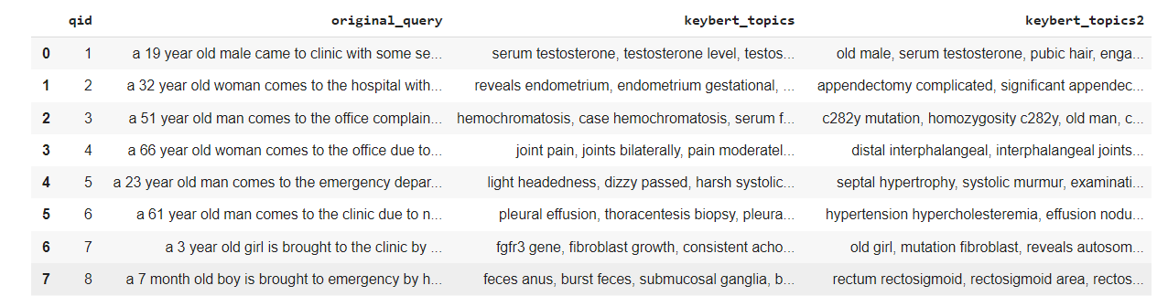

Use of two methods:
1. Regular KeyBert extraction
2. KeyBert with Flair embeddings (more inclined towards syntax aspects)
KeyBert
KeyBert + Flair
which is better?
count of average keywords produced --> 20 both
overlap of keywords produced --> 25% and anlysis of unique one
none of these methods gives us relevnt insights so we procede with manual evaluation --> regular KeyBert is better

Slide 11
6. RANKING ALGORITHM AND RETRIEVAL
RANKING ALGORITHM: employ Terrier's built-in ranking models
BM25: ranking function commonly used in information retrieval. It is an extension of the TF-IDF that introduces document length normalization to mitigate the impact of document length on ranking.
BM25 + RM3: extension of the ranking function that enchnace precision by leveraging user feedbacks and needs
RETRIEVAL: use of BatchRetrieval = retrieving multiple documents at once in response to a user query. Often used in systems like search engines where users expect to see a list of relevant documents rather than individual results (online)

Slide 12
7.EVALUATION:
Reciprocal rank RR(rel=2)@1000: measures the rank of the first relevant document
.
Precision at K(P) P(rel=2)@1,5,10,25,30 and 75 : measures the proportion of relevant documents among the top K retrieved documents.
R-precision Rprec: compares the number of relevant documents retrieved to the total number of relevant documents in the collection.
Recall at K(R): R(rel=2)@10,25: Measures the proportion of relevant documents retrieved out of the total number of relevant documents in the collection.

Slide 13
LIMITATIONS
Dependency on the quality and specificity of patient summaries.
Limited Availability of labelled data which could impact the training of relevance models
Challenges in achieving high precision due to the complexity of medical information.
Leveraging semantics and domain knowledge to better understand the context and nuances of medical information.
Considering the impact of bias and time pressure on the perception of relevance.

